Slide 1
New Prevention: From DREAMS to Reality
Dr. Angeli Achrekar
Office of the Global AIDS Coordinator
U.S. Department of State
July 26, 2018
Notes:
Thank you.
Pleased to talk share and reaffirm our continued commitment to adolescent girls and young women – protecting them and promoting their health and well-being.
Using data to drive programs.

Slide 2
Using Data to Drive Program

Slide 3
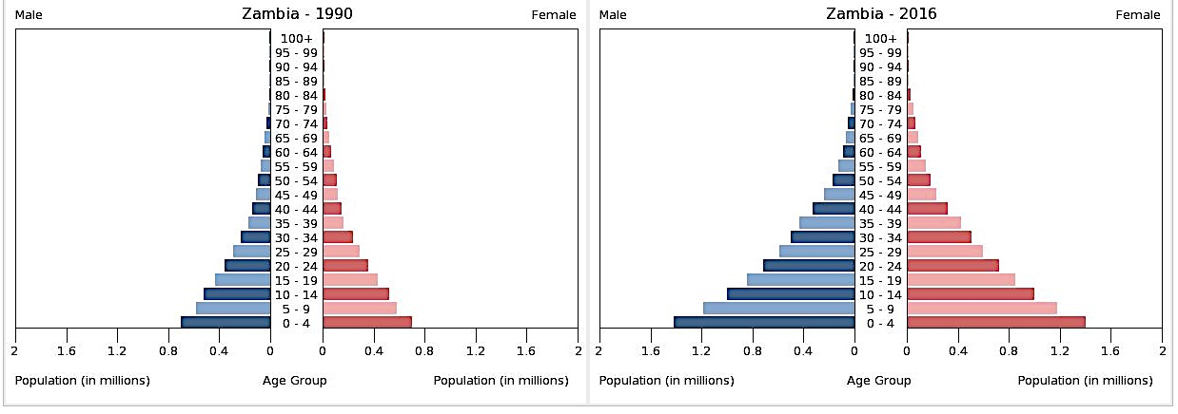
Youth Wave in Zambia
At the beginning of the Epidemic
Today
Young Men Population: 781,000
Young Men PLHIV: 38,000
Young Women Population: 772,000
Young Women PLHIV: 66,000
Young Men Population: 1.6 million
Young Men PLHIV: 48,000
Young Women Population: 1.6 million
Young Women PLHIV: 77,000
Source: US Bureau of the Census , 2017 & UNAIDS, 2017

Slide 4
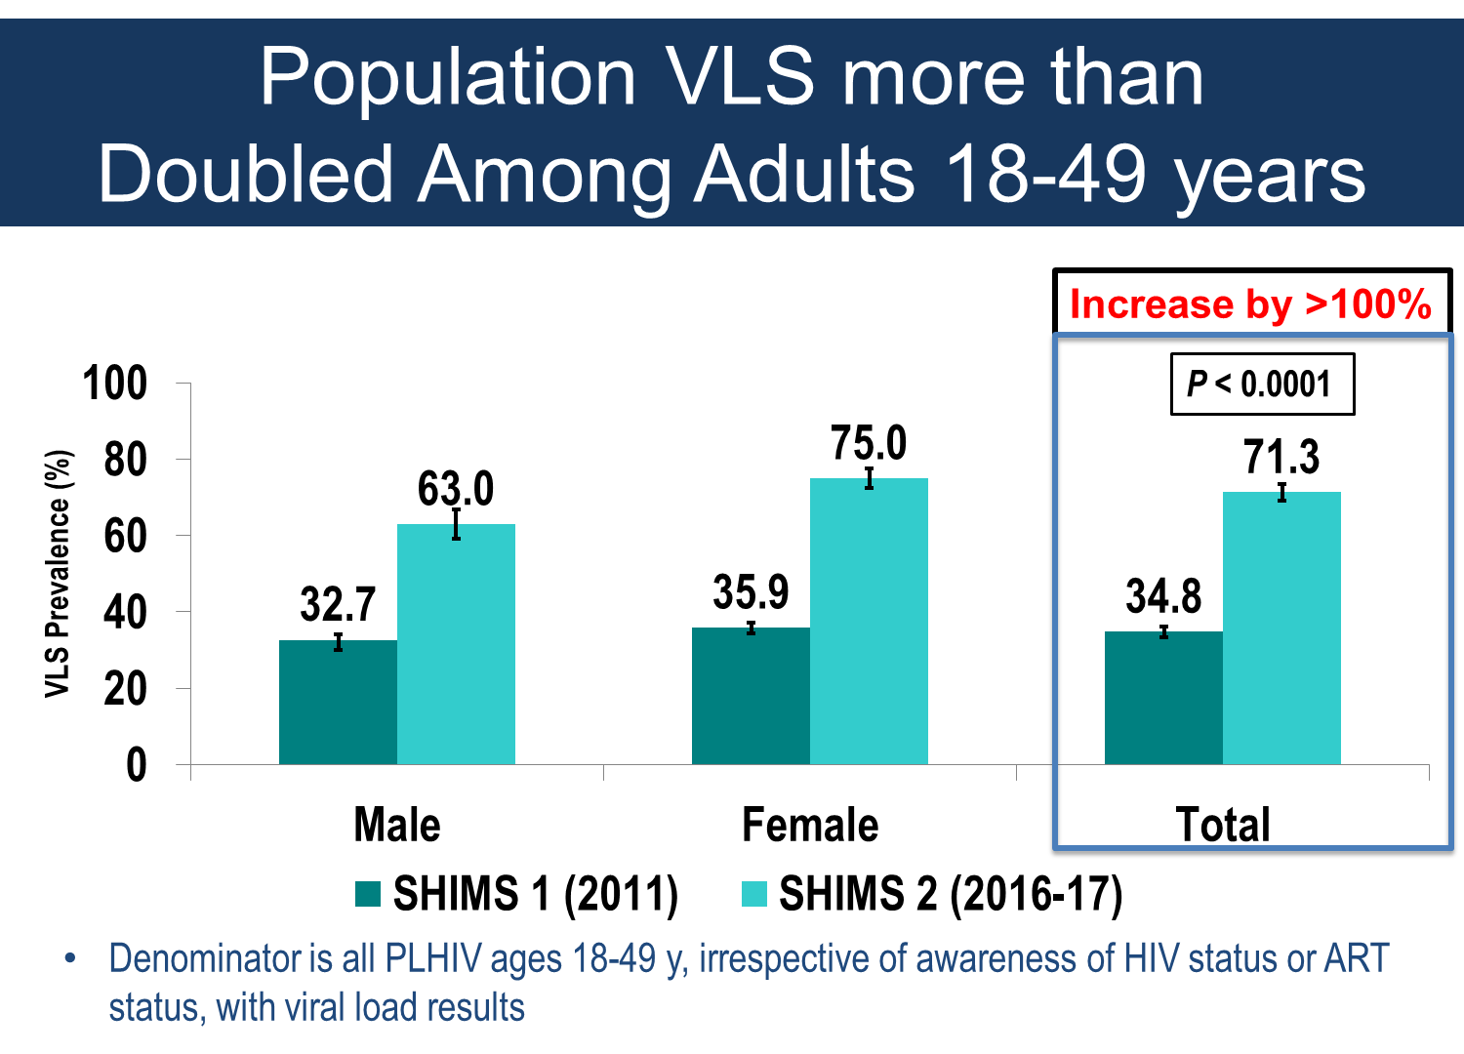
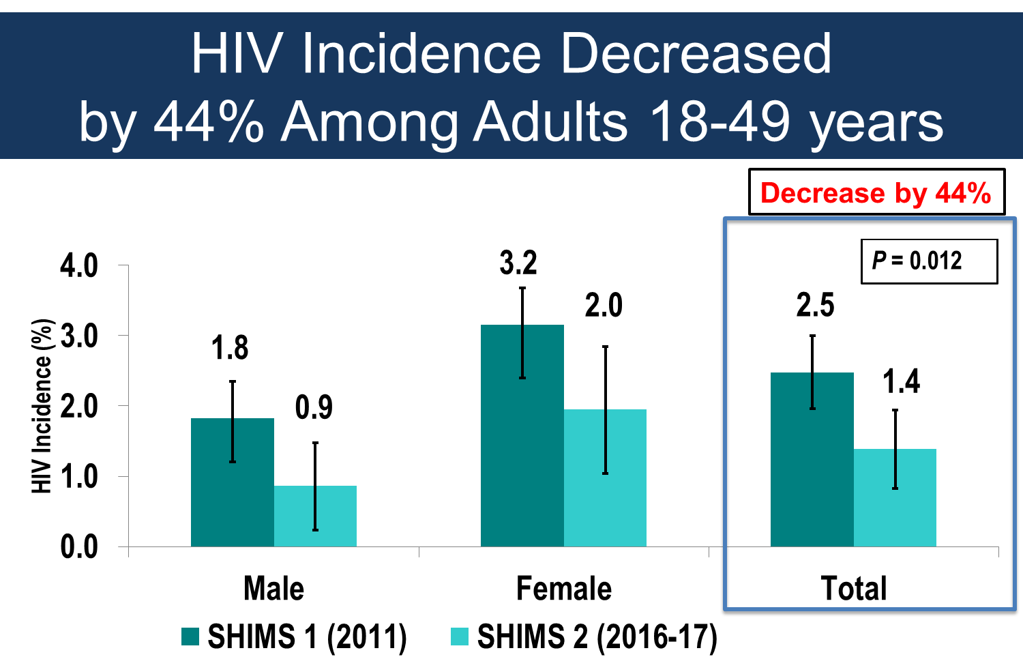
Encouraging Results from Eswatini
As overall incidence decreases through combination prevention, certain populations will need continued, focused, effective prevention

Slide 5
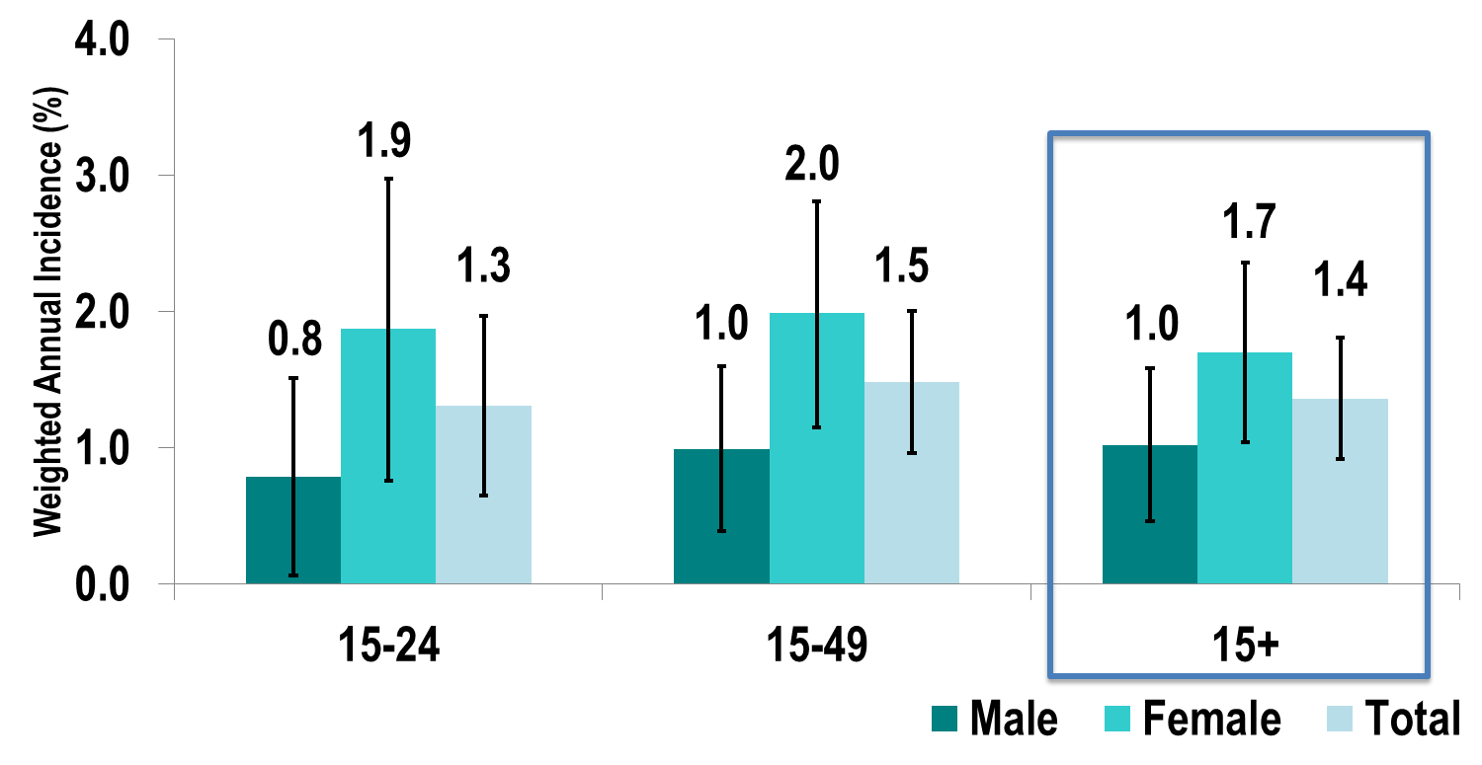
Focusing prevention on high incidence populations

Slide 6
HIV Prevalence by Age and Sex - Malawi
Source: Malawi, PHIA, 2016

Slide 7
Young women experience an elevated risk for HIV infection
Compared to young men, the rate of new HIV infections in young women is:
5 times greater* in Zimbabwe 8 times greater* in Malawi 14 times greater* in Zambia
Our surveys continue to demonstrate this risk to adolescents girls and young women
PEPFAR-supported PHIAs

Slide 8
Percentage of 13-24 Year Old Female Respondents who Experienced First Sex as Forced/Coerced
Note: Zimbabwe1 data only available for 18-24 year olds
Source: CDC Violence Against Children Surveys, PEPFAR-supported
Notes:
And then there is the data from the Violence Against Childrens Surveys that we support in countries.
Here, we see 20, 30, up to over 50% of AGYW ages 13-24 report that their first experience with sex was forced/coerced/ = rape.

Slide 9
Sexual Violence Among 13-24 Year Old Female Respondents Within the Past 12 Months
Note: Zimbabwe1 data only available for 18-24 year olds
Source: CDC Violence Against Children Surveys, PEPFAR-supported
Notes:
And again, a disturbingly high percentage have experiences sexual violence in the last 12 months

Slide 10
PHIA Results Show Achievements towards 90/90/90 Goals

Slide 11
Substantial declines in HIV infections in young people and parents surviving in just 5 years

Slide 12
KEY GAP: Prevention and Treatment Services for Young Men AND Adolescent Girls & Young Women
DREAMS
Risk avoidance and reduction
Sexual violence prevention, PrEP
Finding young men and
ensuring diagnosis and treatment
Girls and
Young Women
Well HIV +
Young Men
25-35 yo
9-24 yo
HIV
Uninfected
Young Men
VMMC Condoms
PrEP
15-30 yo

Slide 13
Increasing funding to prevent infections in boys and young men (VMMC) and adolescent girls and young women (DREAMS)

Slide 14
Cumulative Total: 15.2 million
Source: PEPFAR Results, 2004-2016

Slide 15
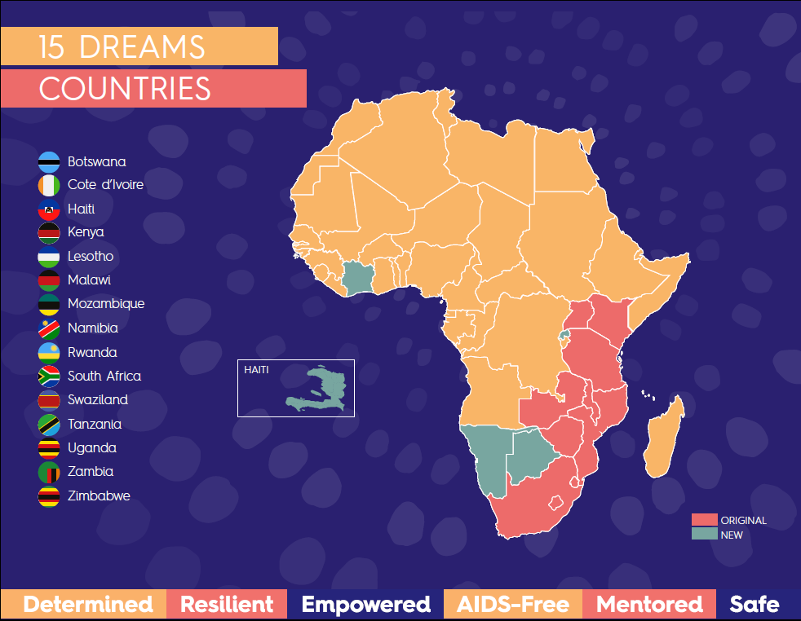
Our Priorities for Adolescent Girls and Young Women
Keep them HIV-FREE focused on structural interventions
Support them to:
Stay in school
Prevent early pregnancies
Prevent sexual violence
Post violence care
Reduce child marriage
Photo credit: USAID/Carole Douglis

Slide 16
The DREAMS Partnership
Public-Private Partnership announced on World AIDS Day 2014
PEPFAR, Bill & Melinda Gates Foundation, Gilead Sciences, Girl Effect, Johnson & Johnson, ViiV Healthcare
Over $800 million USD and growing…
Complementary funding to scale up VMMC and test & start for young adult men in DREAMS districts
Notes:
We said – enough is enough – we will put our energy and resources behind changing the outcome for AGYW.
And DREAMS was launched – we created it together with AGYW, civil society, governments, and partners.
Largest investment PEPFAR has ever made to change the trajectory of AGYW.

Slide 17
The Core Package
Empower Girls & Young Women and reduce risk
Mobilize Communities for change engaging local leaders
Reduce Risk
Strengthen Families and engage faith leaders
Community Mobilization & Norms Change
School-Based
Interventions
Additive Funding VMMC
Additive Funding
TX for Men
Characterization of male partners to target highly effective interventions (HTS→ART, VMMC)
Social Protection
(Education Subsidies, Combination
Socio-Economic Approaches)
Youth-friendly sexual and reproductive health care (Condoms, HTC, PrEP, Contraceptive Mix, Post-violence care)
Social Asset Building

Slide 18
Approach in Mozambique
20-24 year olds
Preventing HIV and Sexual Risk Reduction
9-14 year olds
Social asset building
Parenting programs
15-19 year olds
Contraceptive method mix
Economic strengthening
Violence prevention curriculum
Preventing HIV and violence
Contraceptive method mix
Violence prevention curriculum
Economic strengthening
Preventing HIV and Sexual Risk Reduction
HIV testing
Post-violence care
Preventing vertical transmission
Linkages to OVC
Linkages to Care & Treatment
APPROACH
Adolescent friendly services
Safe spaces
Peer to peer educators
Girls clubs
Social Asset building
Savings groups
Parenting programs
OUTCOMES
Linkages between services
Retention
Delayed sexual debut
Decrease early pregnancy
Reduced HIV incidence
Economic empowerment
Notes:
DREAMS takes lessons learned from previous interventions in Mozambique to implement practical intervention models that have demonstrated feasibility and acceptability
Establishing quality adolescent friendly health services and prevention platforms in and out of school settings.
Provinding post violence care to victims of Gendar Based Violence.
Enhancing linkages with the OVC platform savings groups, educational subsidies and caregivers programs.
Delivering community mobilization and norms change interventions.

Slide 19
Notes:
Launched in Dec 2014, started implementation in 2015 – By the end of 2017, the program – which addresses structural, community, and individual issues – has already reached over 2.5 million AGYW

Slide 20
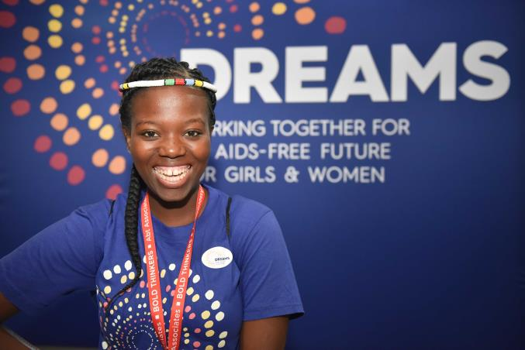
65% of DREAMS districts show a 25-40% decline in new HIV diagnoses
Notes:
Perhaps most exciting is that most DREAMS districts showed real impact – a 25-40% decline in new HIV diagnoses.

Slide 21
DREAMS Programming Impact Grouped by percent of districts in each country with a greater than 25% decline
100% of Districts
80% of Districts
<50% of Districts
Notes:
Mozambique and the others on the left side already showing very real impacts.

Slide 22
Districts with > than 25% declines (2/3rd)
Percent Decline

Slide 23
Districts <25% declines (1/3rd)
Percent Decline

Slide 24
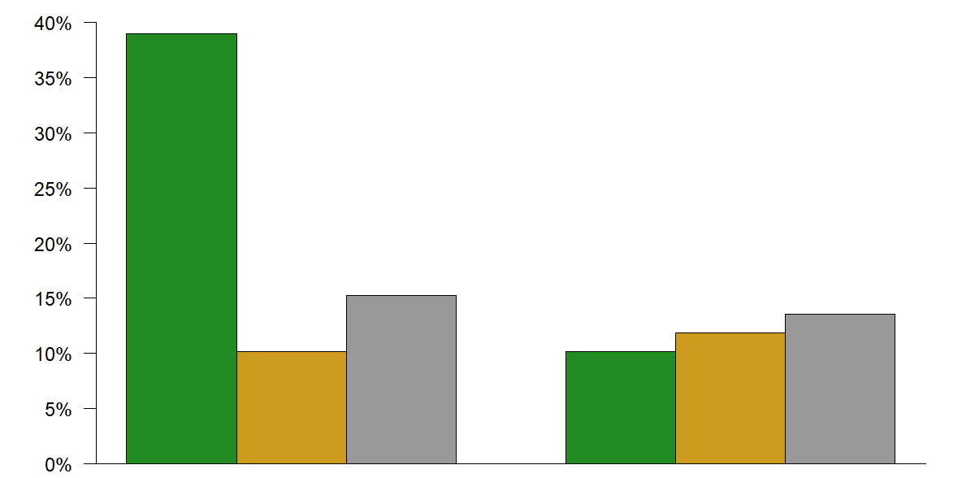
Declines by District Type (Rural, Urban, Mixed) Differences between DREAMS Districts with Higher and Lower Declines in New Diagnoses among AGYW
Rural
Mixed
Percent of Districts
Urban
Districts > 25% decline
Districts < 25% decline

Slide 25
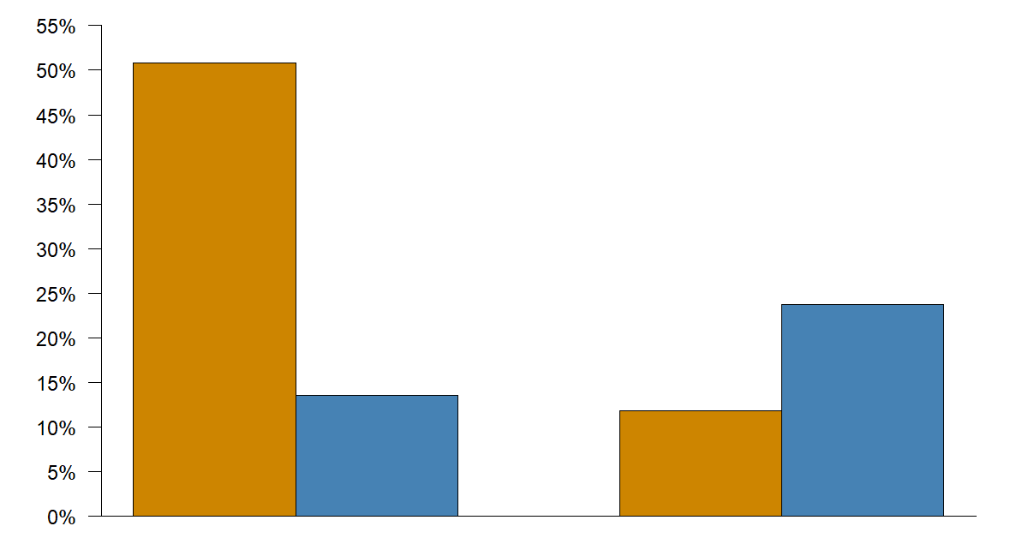
DREAMS Programming Coverage within Districts Differences between DREAMS Districts with Higher and Lower Declines in New Diagnoses among AGYW
Full Coverage
Partial Coverage
Percent of Districts
Districts > 25% decline
Districts < 25% decline

Slide 26
Going Forward
Ensuring long-term investment and focus by incorporating funding into field programming
Increasing support to AGYW in large urban areas
Focusing on:
Ending sexual violence/assault/rape of 9-14 year old girls
Increasing secondary school to decrease the incidence of HIV and child marriage
Continuous listening, learning and modifications of the program based on data and AGYW for the greatest impact
Notes:
Going forward, we continue to commit to:
ensuring long-term investment in AGYW
Address the persistent issues we are seeing in the urban areas
Never stop listening, learning, and improving the program to best meet the needs of AGYW

Slide 27
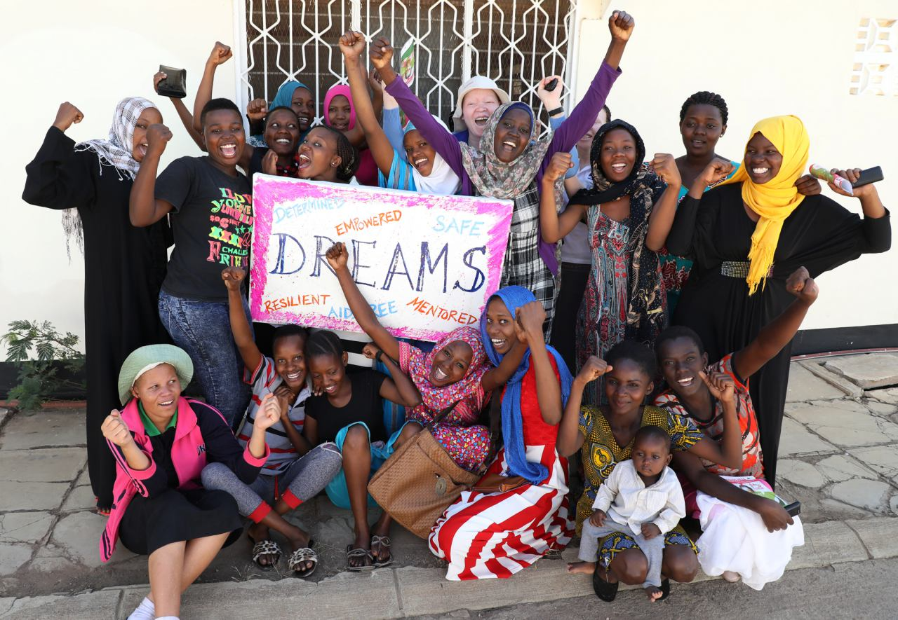
THANK YOU!

